Slide 1

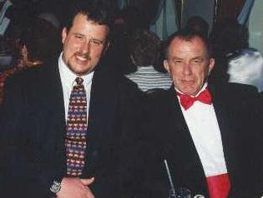
Exposure CS 2021
for CS1
Chapter 1 Section 1-8 Slides
Introduction to Computer Science:
Learning CS & How Computers Work
PowerPoint Presentation
created by:
Mr. John L. M. Schram
and Mr. Leon Schram
Authors of Exposure
Computer Science

Slide 2
Section 1.1
Learning the
Exposure Way

Slide 3
The “Nothing is Obvious” Story
Imagine a young boy in the Amazon jungles.
This boy has always lived in the jungle without
any modern conveniences. He has never been
in a city; he has never seen a television nor seen a book.
Now imagine that for some unknown reason this young boy travels to Colorado in the Winter time. The little boy stands in a yard somewhere and watches the snow with bewilderment. He is astonished; he does not understand what is falling from the sky.
Another little boy, about the same age, from Colorado, looks at the boy's behavior. The Colorado boy is confused, why is the boy acting so odd?
Obviously it is snowing, so what is the big deal?

Slide 4
Corn Flakes & Iced Tea
Most Americans consider it "obvious" that cold milk is poured on corn flakes. However, in Europe, everybody knows you put warm milk on your cereal.
Most Europeans consider it "obvious" that Tea is to be served warm, preferably hot. They are completely baffled when Texans actually put ICE in their Tea.

Slide 5
Section 1.2
The Exposure
Equation

Slide 6
The Exposure Equation
Bewilderment + Exposure = Obvious

Slide 7
Exposure in Extracurricular Activities
Drill team performance
Half-time band show
Football Team blocking
Basketball free throws
Baseball batting

Slide 8
The Curious Exposure Discrepancy
Students recognize that only continuous practice will result in a good showing at a brief performance or brief competition.
Many of the same students barely read or practice a topic once for an academic subject.
It appears that preparation for a known, short performance requires practice, but preparation for life receives only minimal effort from many students.

Slide 9
Section 1.3
Getting
Started

Slide 10

Computer Fundamentals
First, this is a class in Computer Science, not Computer Literacy or Computer Applications.
The course that you are taking assumes that this is your first formal computer science course.
Furthermore, it is also assumed that you have no knowledge of programming.
If you do know some programming,
fine, but it is not a prerequisite.
This means that we should start at

Slide 11
Section 1.4
How Do
Computers Work?

Slide 12
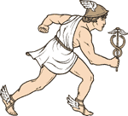
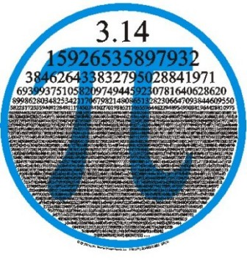
Three Ways Where Computers Beat People
Computers are faster.
Computers are more accurate.
Computers do not forget.
NOTE: Computers do not
have intelligence or creativity.

Slide 13
Section 1.5
Communication
with Morse Code

Slide 14
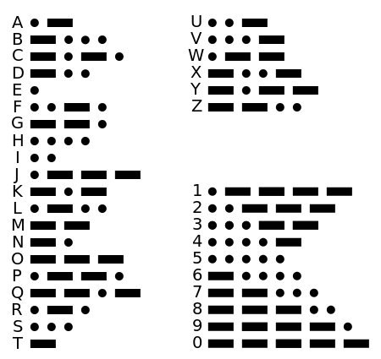
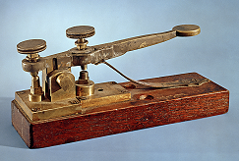
Morse Code

Slide 15
Section 1.6
Storing Data
Electronically
with 1s & 0s

Slide 16
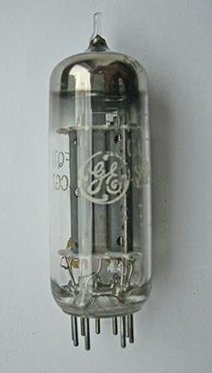
Early Computers Used Vacuum Tubes
They would turn on and off like light bulbs.
On represented a 1.
Off represented a 0.
Problems with Vacuum Tubes:
They were big and bulky.
They would get hot and burn out.

Slide 17
Bits, Bytes & Codes
Bit is a binary digit that is either 0 (off) or 1 (on)
1 Byte = 8 bits
1 Nibble = 4 bits (½ a byte)
1 Byte has 2⁸ or 256 different numerical combinations.
ASCII uses 1 byte (code values 32-127) to store 1 character.
Unicode uses between 1 and 4 bytes to store a character.
UTF-8 is the most common encoding system for Unicode and allows up to 1,112,064 different characters.

Slide 18
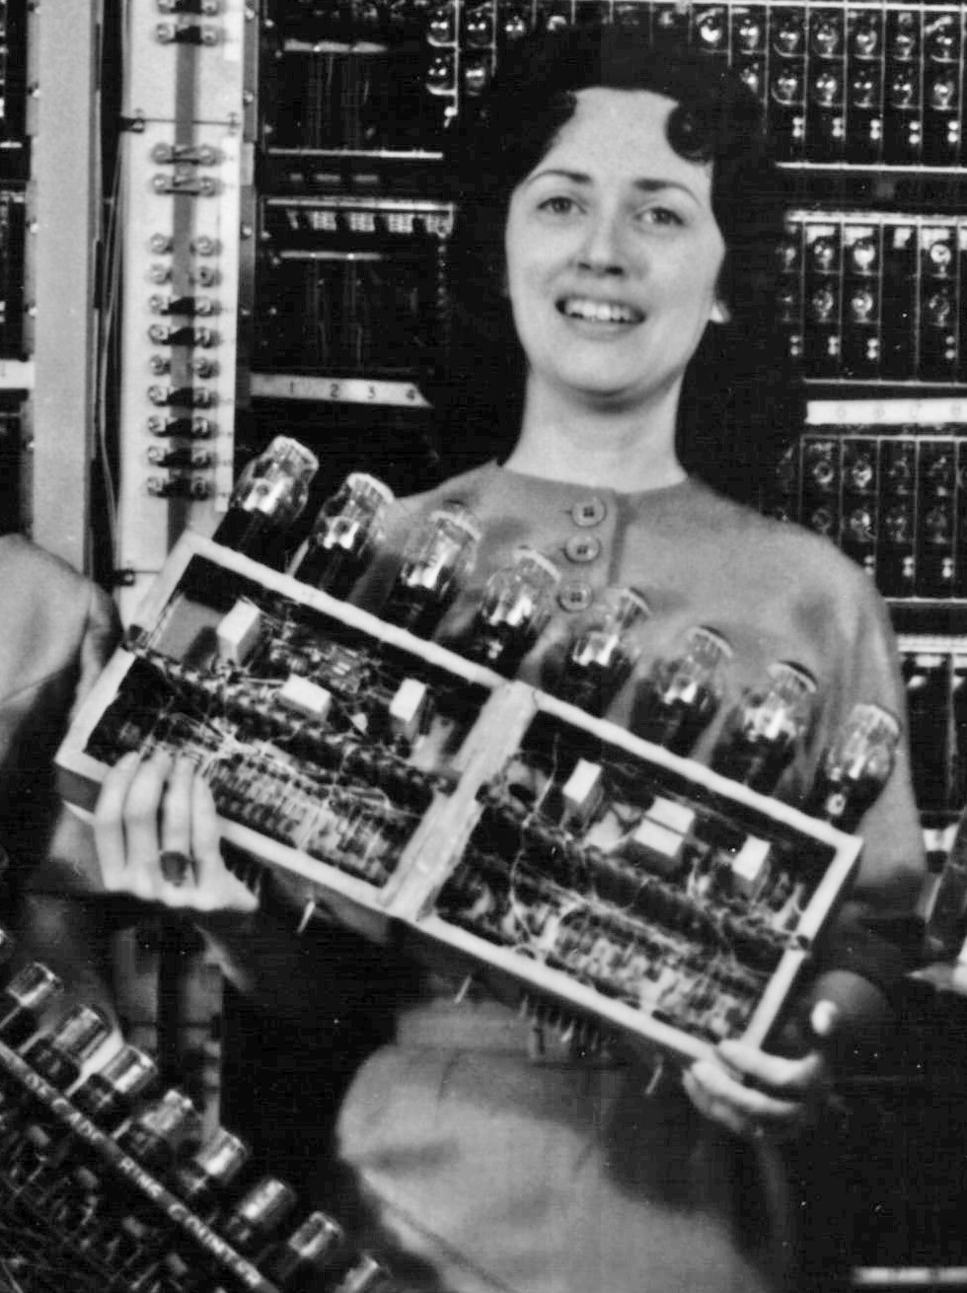
Holding One Byte of Information in 1945 https://commons.wikimedia.org (Public Domain, Cropped Image)

Slide 19
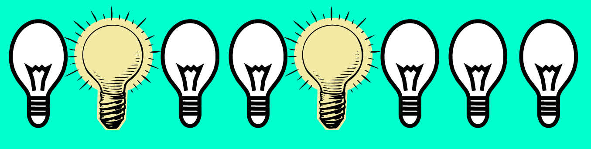
Electronic Memory
off | on | off | off | on | off | off | off
0 | 1 | 0 | 0 | 1 | 0 | 0 | 0

Slide 20
Decimal (Base-10) Number System
The number system that we use is called the decimal number system or base-10.
It is called “base-10” because it has 10 digits (0 – 9).
Rumor has it that people developed a base-10 system, because of our ten fingers.
Consider the base-10 number 2,345,678
10⁶ | 10⁵ | 10⁴ | 10³ | 10² | 10¹ | 10⁰
1,000,000 | 100,000 | 10,000 | 1,000 | 100 | 10 | 1
2 | 3 | 4 | 5 | 6 | 7 | 8

Slide 21
Binary (Base-2) Number System
The number system used by computers is the binary number system or base-2.
Only the digits 0 and 1 are used.
Remember that modern computers use electricity, which is either on or off. 1 means on. 0 means off.
Consider the base-2 number 01000001
Can you tell that this is equal to the base-10 number 65?
2⁷ | 2⁶ | 2⁵ | 2⁴ | 2³ | 2² | 2¹ | 2⁰
128 | 64 | 32 | 16 | 8 | 4 | 2 | 1
0 | 1 | 0 | 0 | 0 | 0 | 0 | 1

Slide 22
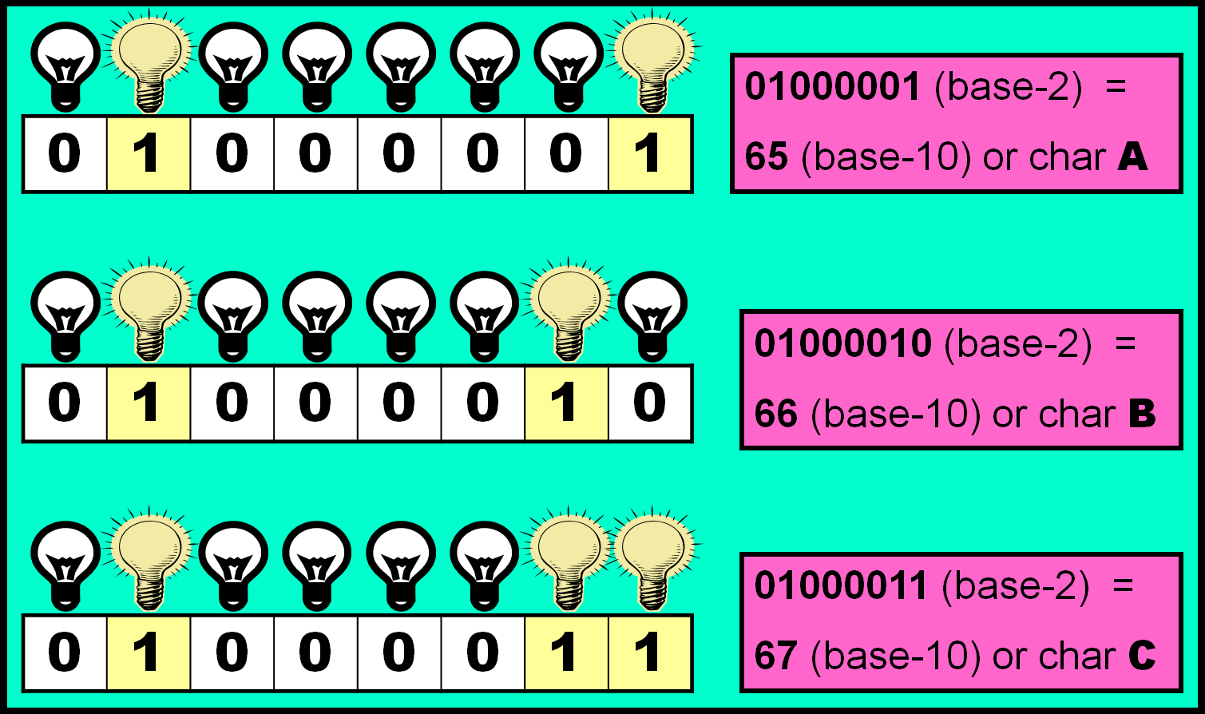
Three Combinations of 8 Light Bulbs

Slide 23
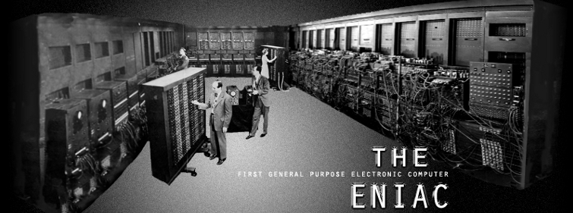
ENIAC 1946
The ENIAC was the first electronic general purpose computer.
With over 17,000 vacuum tubes, the machine was the size of a gymnasium and cost $500,000.
This was the first computer used to calculate the value of π.

Slide 24
Section 1.7
Memory and
Secondary Storage

Slide 25
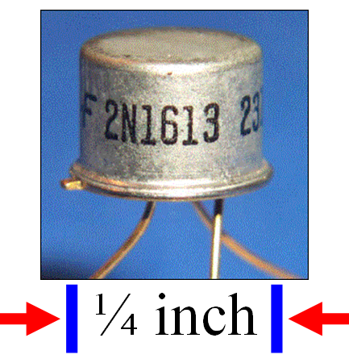
The Win-Win-Win with Transistors
Transistors have major advantages over Vacuum Tubes:
They are much smaller.
They do not get hot and burn out.
This lead to the invention of integrated circuits and later microchips, which allowed modern computers to become much smaller and considerably less expensive.

Slide 26
Motherboard & Computers Chips
motherboard
The main board with all the primary computer components. Has several computer chips attached:
Read Only Memory (ROM)
This chip stores permanent information for the computer.
Random Access Memory (RAM)
This chip stores temporary information for the computer.
Central Processing Unit (CPU)
This chip is the “brains” of the computer.

Slide 27
Measuring Memory
KB | Kilo Byte | 1 thousand bytes | 1,000
MB | Mega Byte | 1 million bytes | 1,000,000
GB | Giga Byte | 1 billion bytes | 1,000,000,000
TB | Tera Byte | 1 trillion bytes | 1,000,000,000,000
PB | Peta Byte | 1 quadrillion bytes | 1,000,000,000,000,000
EB | Exa Byte | 1 quintillion bytes | 1,000,000,000,000,000,000
ZB | Zetta Byte | 1 hexillion bytes | 1,000,000,000,000,000,000,000
YB | Yotta Byte | 1 septillion bytes | 1,000,000,000,000,000,000,000,000
Note: Technically, a kilobyte is exactly 2¹⁰ or 1024 bytes.

Slide 28
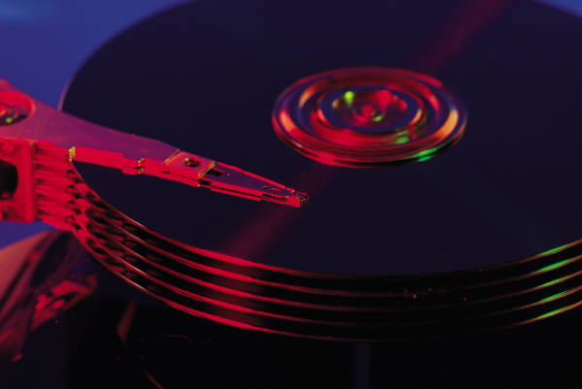

Secondary Storage Devices
Since RAM is lost when the computer is turned off, files must be saved to some secondary storage device for later use.

Slide 29
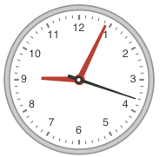
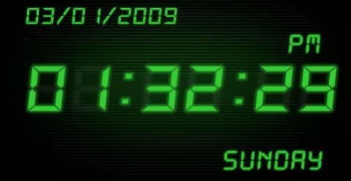
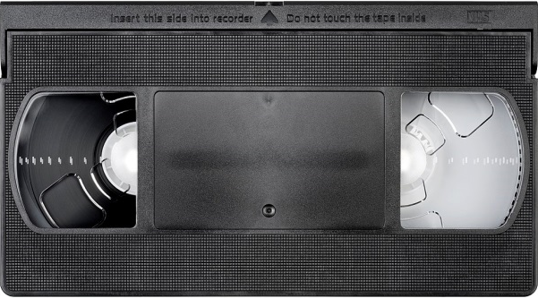
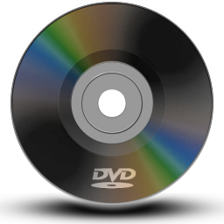
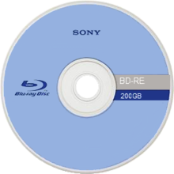
Analog vs. Digital
Analog Devices | Digital Devices
Measures continuously. | Measures in increments.
Copies are not as good as the original. | Copies are IDENTICAL to the original.

Slide 30
Section 1.8
Hardware &
Software

Slide 31
Hardware
Hardware refers to physical pieces of computer equipment.
This included the main computer system unit, as well as all of the peripherals (things that plug into the computer.)

Slide 32
Software
Software provides instructions to a computer.
The most important aspect of this course is to learn how to give correct and logical instructions to a computer with the help of a programming language.
Software falls into two categories:
System Software
Application Software.
Applications Software refers to the instructions that the computer requires to do something specific for you.
Word Processors and Electronic Spreadsheets are the two most common applications for a computer.
System Software refers to the instructions that the computer requires to operate properly.
The major operating systems are Windows, UNIX, Linux & the MAC OS.

